Slide 1


Pollution Prediction using GNN’s in Delhi-NCR
Vedant Vijay
2017CS10388
Supervisors: Sayan Ranu, Rijurekha Sen

Slide 2


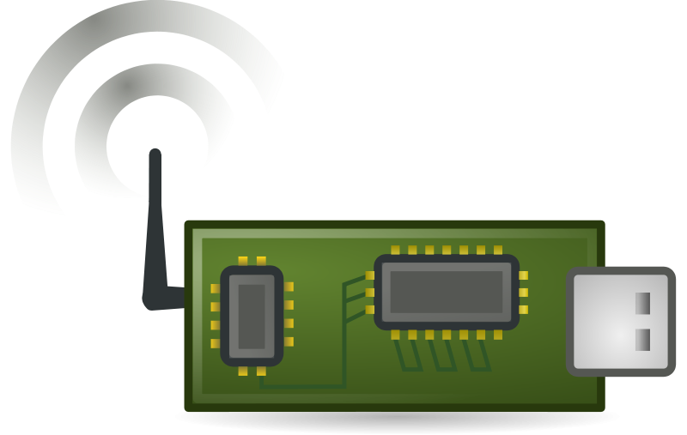
Previously….
How to measure Pollution Effectively in almost real time?
- Interpolate pollution values based on values of neighbours.
Local Buses Equipped sensors Interpolation
Partial Data
Interpolation
Complete Data
Known value
Idea: Graphs
-Deploy a GNN that can learn relationships(weights) and interpolate to unknown values.
-Had no results, stuck at Hyperparameter tuning.
Known value
w₁
w₂
Unknown value
w₄
w₃
Known value
Known value

Slide 3
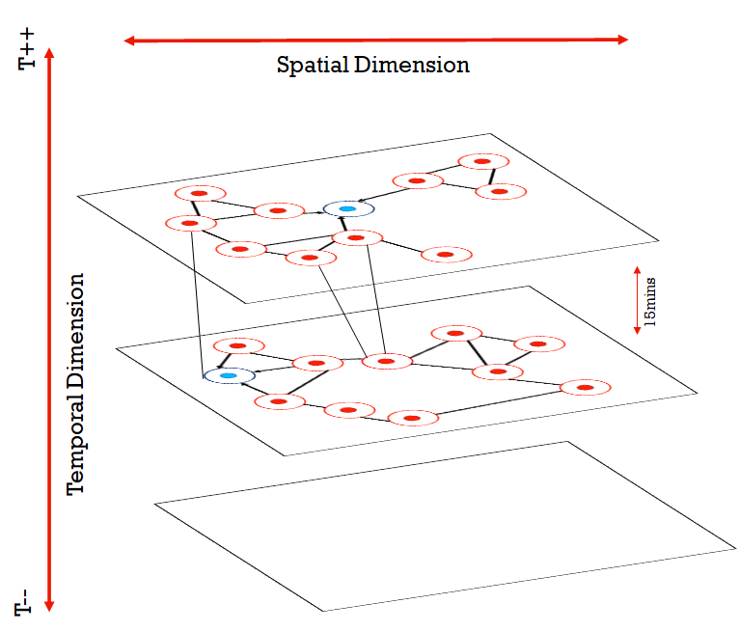
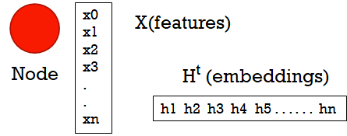
What is a GNN?
Neighborhood data sharing among nodes of a graph in form of intermediate embeddings.
H = F (H, X)
O = G (H, X)
H ^{t+1} = F (H^{t} , X) by Banach’s Fixed Point Theorem
F is generally an aggregation function, while G is Linear NN.
GraphSage & GCN.
T++

Slide 4
Assumptions and Modelling:
PM10 value
Boolean if known or unknown
X (2)
. . .
. . .
Edge if 500m Space &
2Hr Time
H 1.1 ( 24 ) Mean Pool
H 1.2 ( 8 ) Max Pool
200m radius,
15min radius
. . .
. . .
H 2.1 ( 12 ) Mean Pool
H 2.2 ( 4 ) Max Pool
A data point, as recorded by Bus Sensor
at lat, long, time.
16 x 5 x 1 Linear NN
Predicted PM10 value
Y (1)

Slide 5
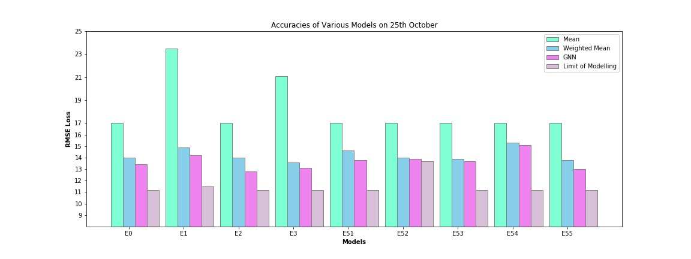
Hyperparameter Tuning
Weight(w) = f(d, Δt)
Known
X₁,Y₁
X₂,Y₂
Node radius(r)
Edge if d<d₀
Node Radius and Intra Node distance for an edge.
Edge weights = f(x1,y1,x2,y2,t1,t2) ~ f(xy-dist, t-dist)
No. of sub graphs in Random sampling – 50,100,500...
Known Nodes/Total Number of Nodes – 0.9, 0.8, 0.7…
Known/Total = 2/3= 0.65
X₃,Y₃
Known
Unknown
Rmse values compared on Test Data:
Mean: 16 – 25
Weighted Mean: 13.5 – 15
GNN 13 – 14
Limit of the Model: 11.5 (Based on structural assumptions)
Pollutant(pm10) value ranging from 200 - 500

Slide 6
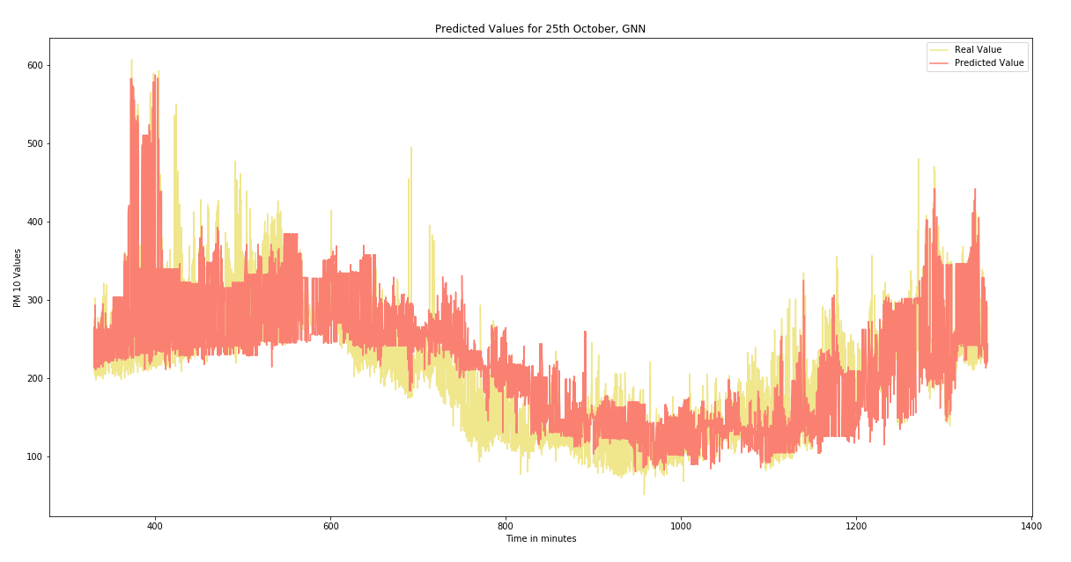
Other Enhancements:
Techniques:
Original features used in every layer Graph Sage network(No change)
Added Time, Latitude and Longitude in feature Space(No change)
Connection to a node limited to only 1 instance in time(Improved accuracy)
Nodes connected to only the past nodes.(Reduced accuracy)
R squared added as a test methodology
Augmented Data added(No change)
Predicted values for 25th October, 2020

Slide 7
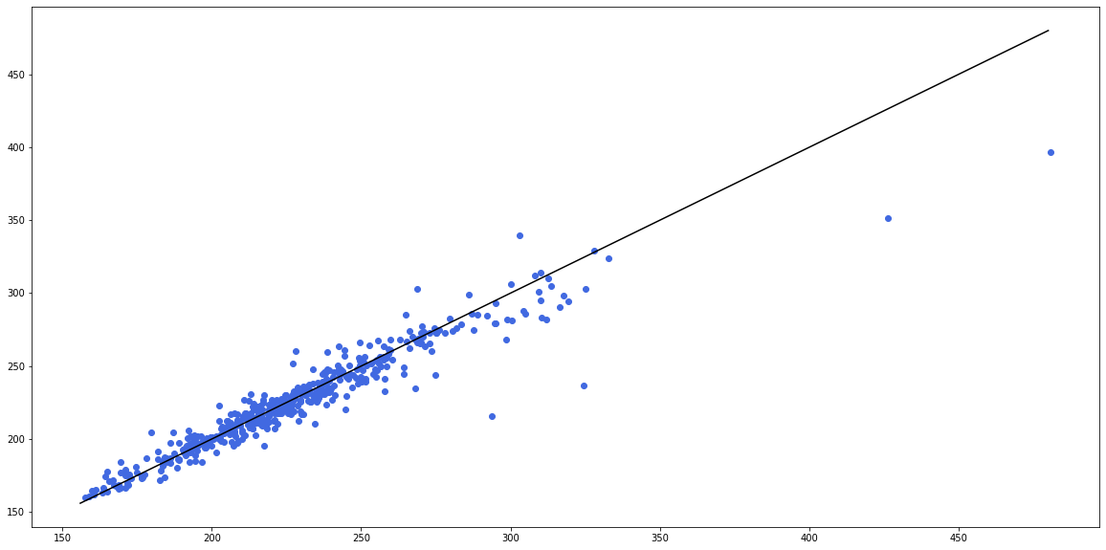
GNN performance on 25th October RMSE: 14.68
Predicted pollutant value
Original pollutant value

Slide 8
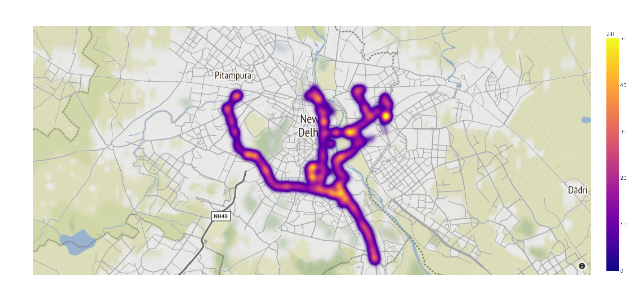

Achievements
Problems
Accuracies Brilliant – Problem in Data.
Buses travelling on constant route.
Required data from randomly moving taxis, vehicles, bikes.
RMSE Achieved ~ 14.0 @pm10 level 200-500 i.e. error < ~5-10% average.
Known nodes/Total nodes was 0.7
GNN performed better, even better than Gaussian Processes (parallel experiment), RMSE ~30
=> GNNs are inherently suited for interpolation. GNNs have not been applied previously on interpolation.
Can’t predict on regions not on route.
Inference lacks reliability
but
Looks Good!

Slide 9
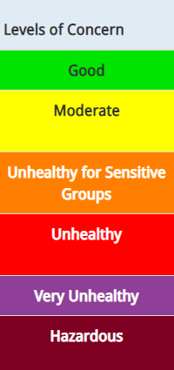
Is there nothing we can infer? Why are we pursuing? Sample experiment, Sensor is cheap, gives real time estimates.
Inferences
How many sensors? 1 Sensor(priced ₹5,000) vs ₹ 5Lakh grade station sensor. Currently 8, if increased to 100, exceptional performance possible.
Even with this model, we can predict categorical accuracies for regions for +30mins bus visit and within 500mtr radii. (95% of values lie within one category error.)
Bus data can be used to alert in alarming situations arose abruptly in some region.
Static sensor replacement??

Slide 10
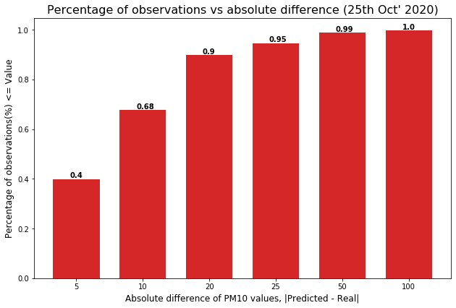

Slide 11
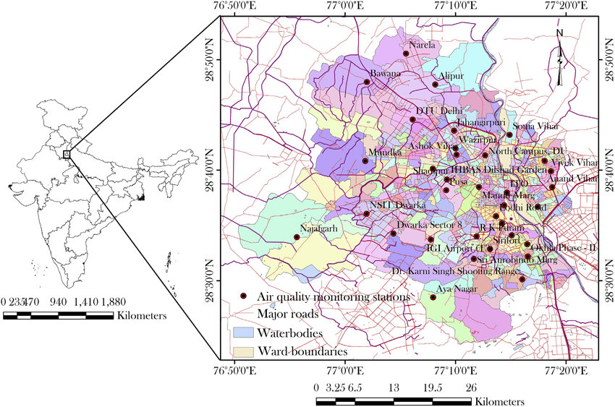
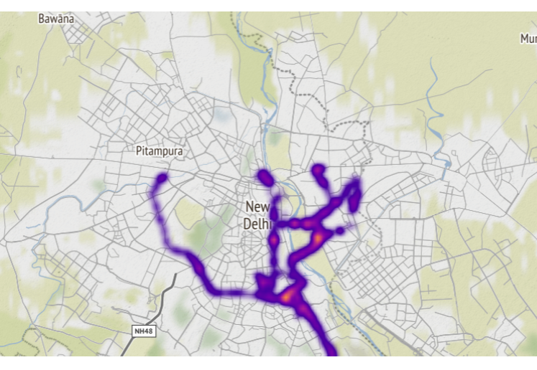
Static Delhi Pollution Board Sensors
Our Bus Route

Slide 12
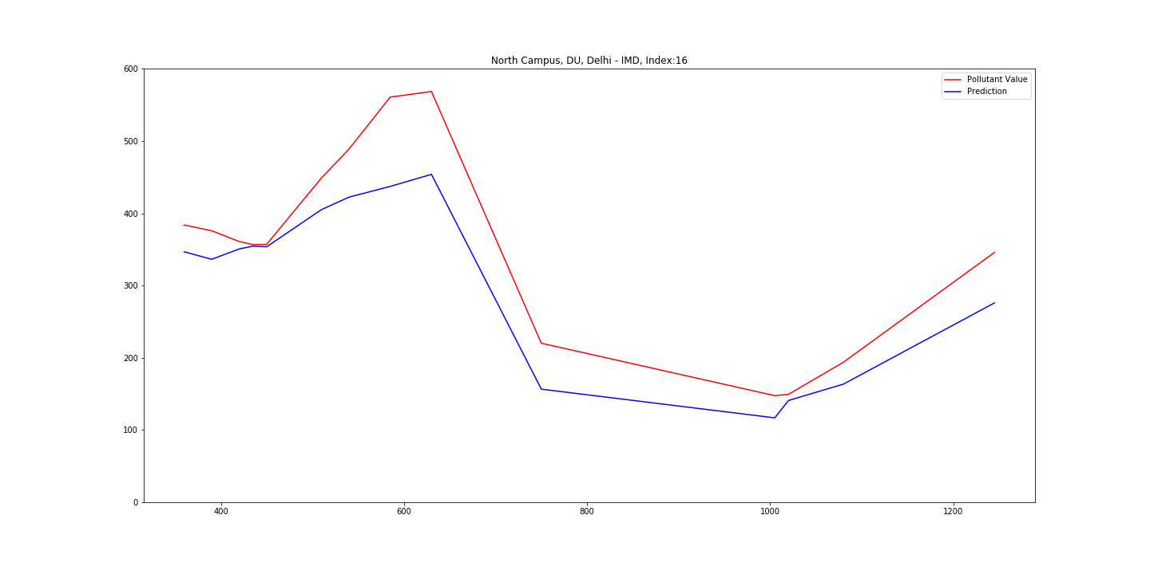
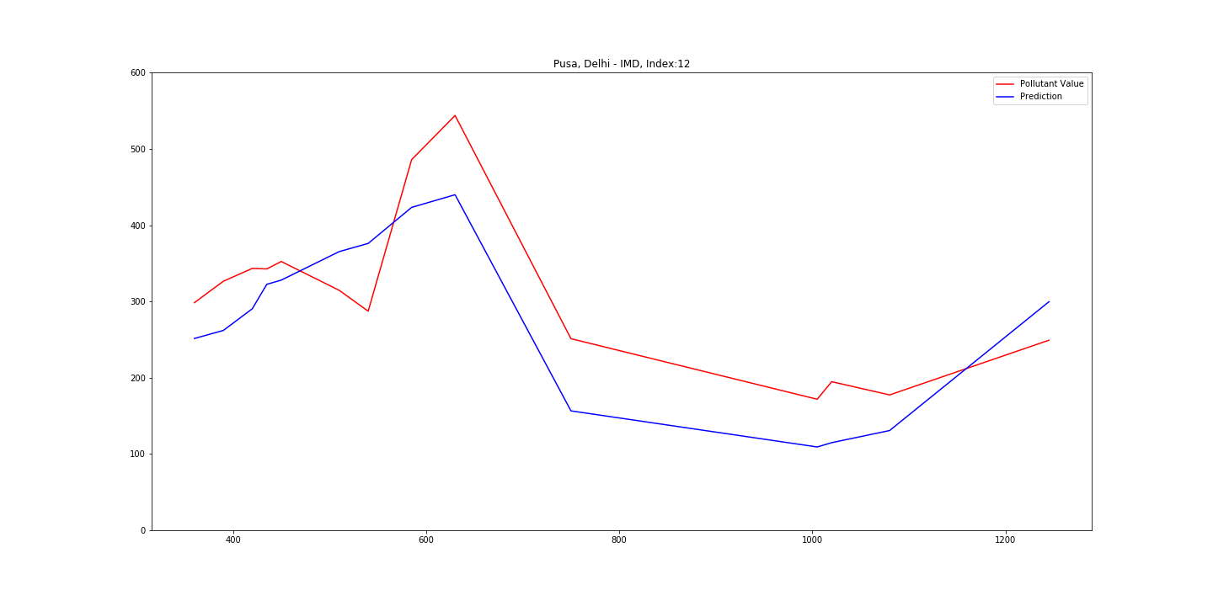
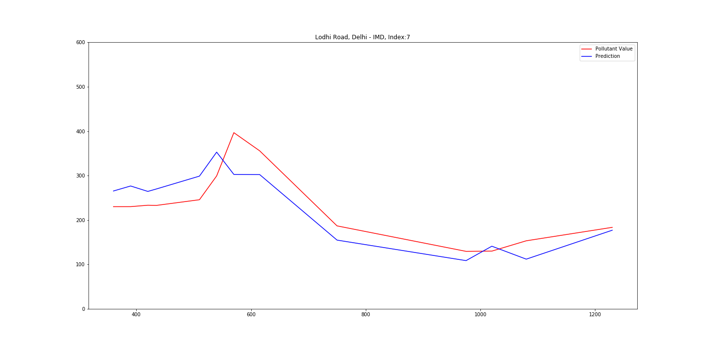
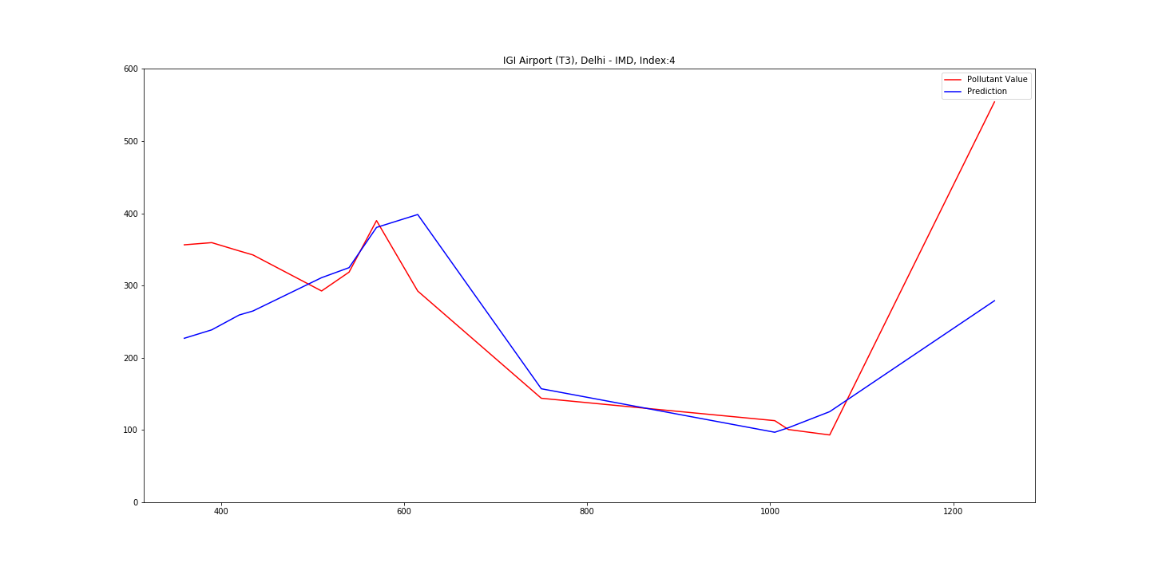
Predicted(Blue) vs Real(Red) pm10 value for static sensors using Bus Data & GNN on 13th Nov’2020
North Campus, DU
Pusa, Delhi
Lodhi Road, Delhi
Good
Predictions
IGI Airport T3, Delhi

Slide 13
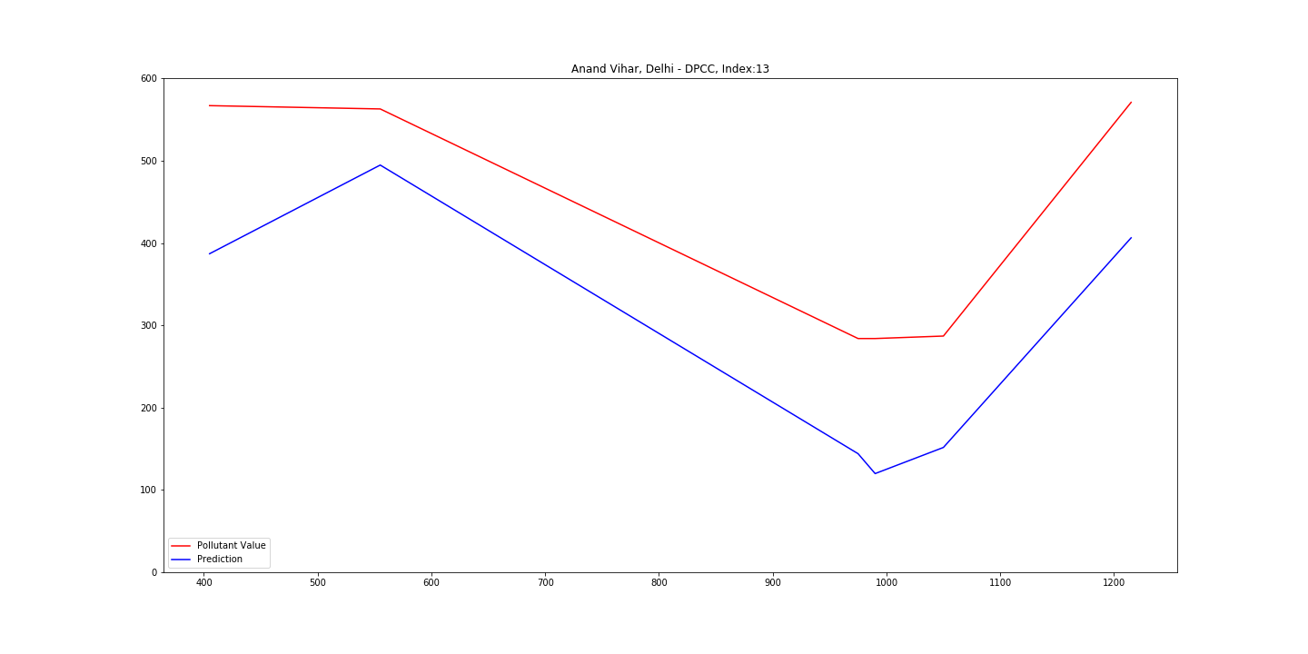
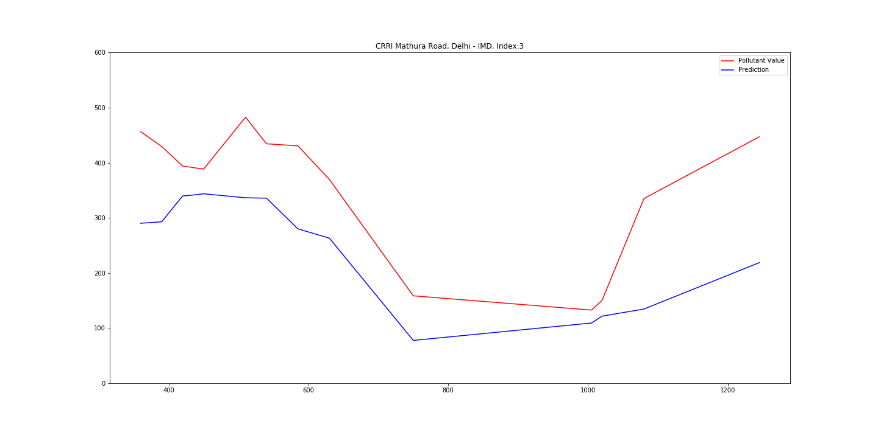
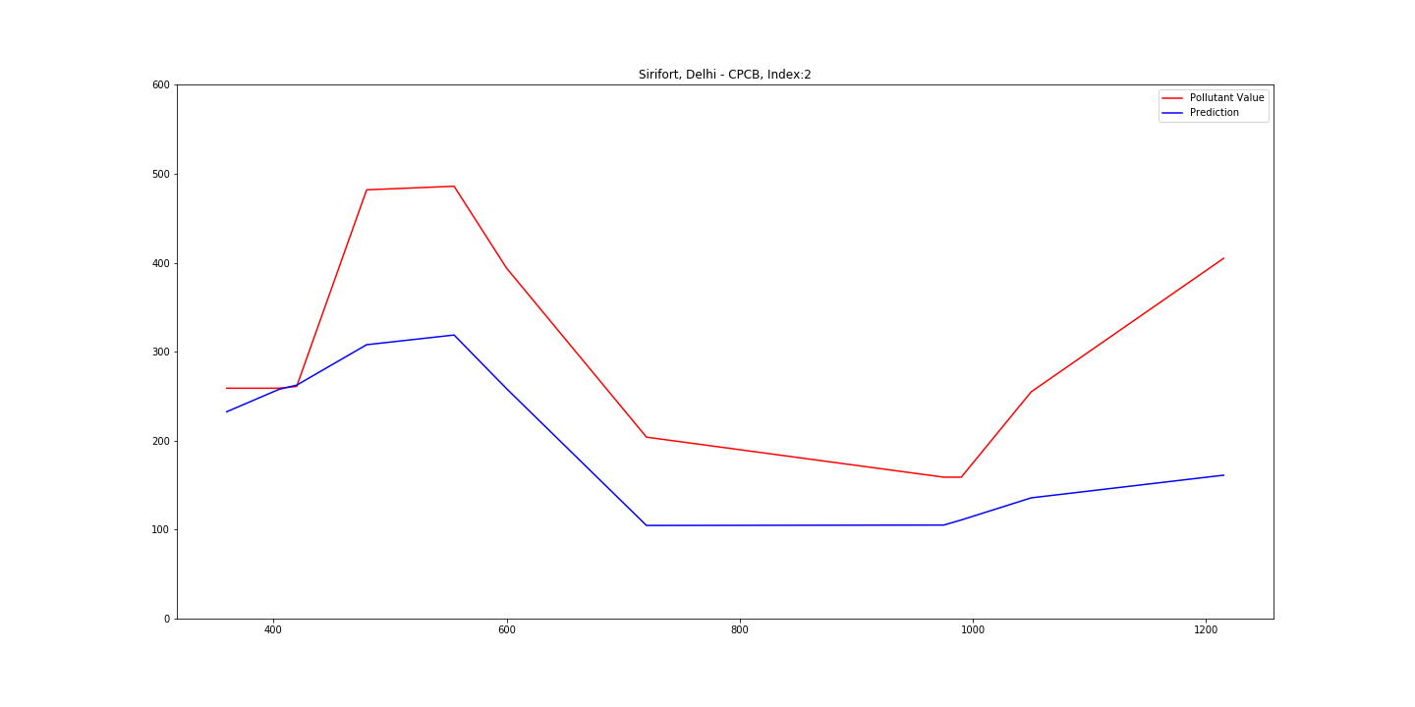
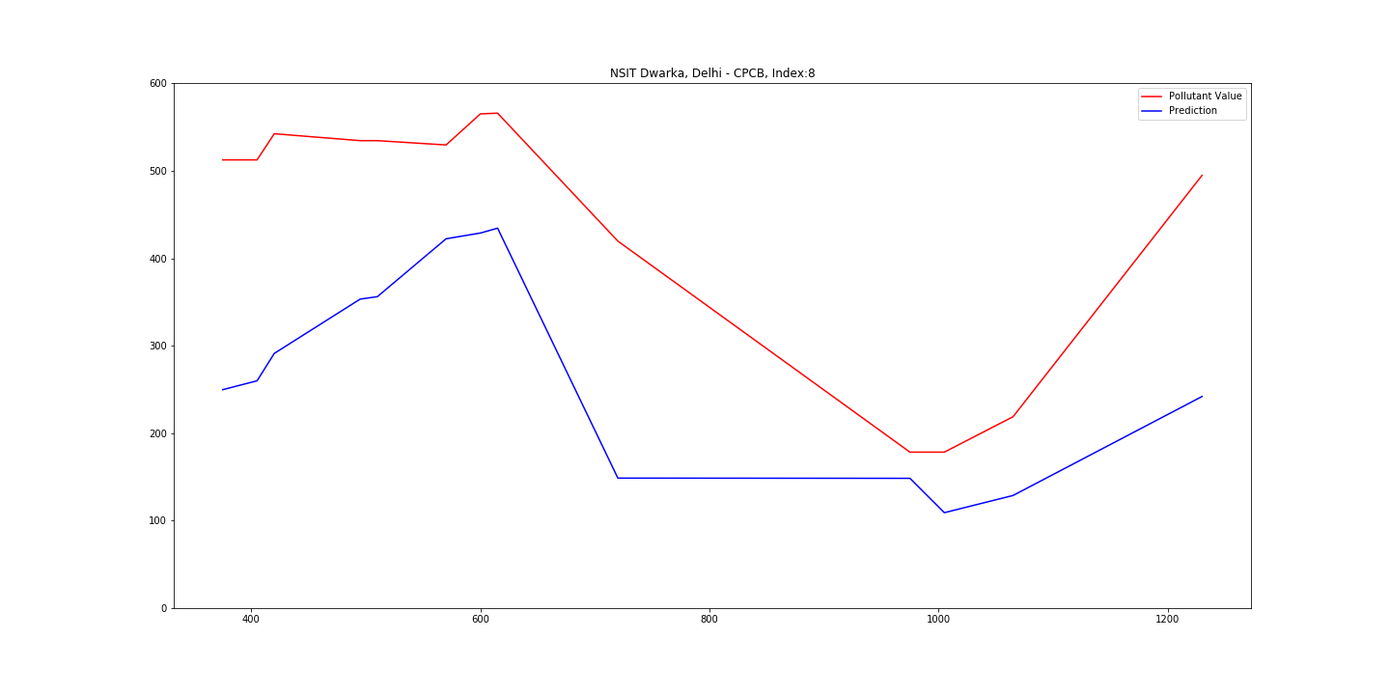
Anand Vihar
Mathura Road, Okhla
BAD
Sirifort, Delhi
NSIT Dwarka

Slide 14
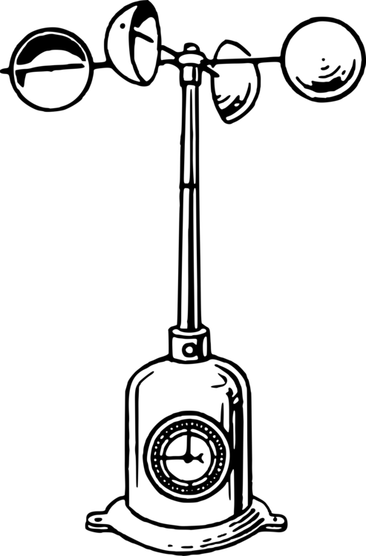
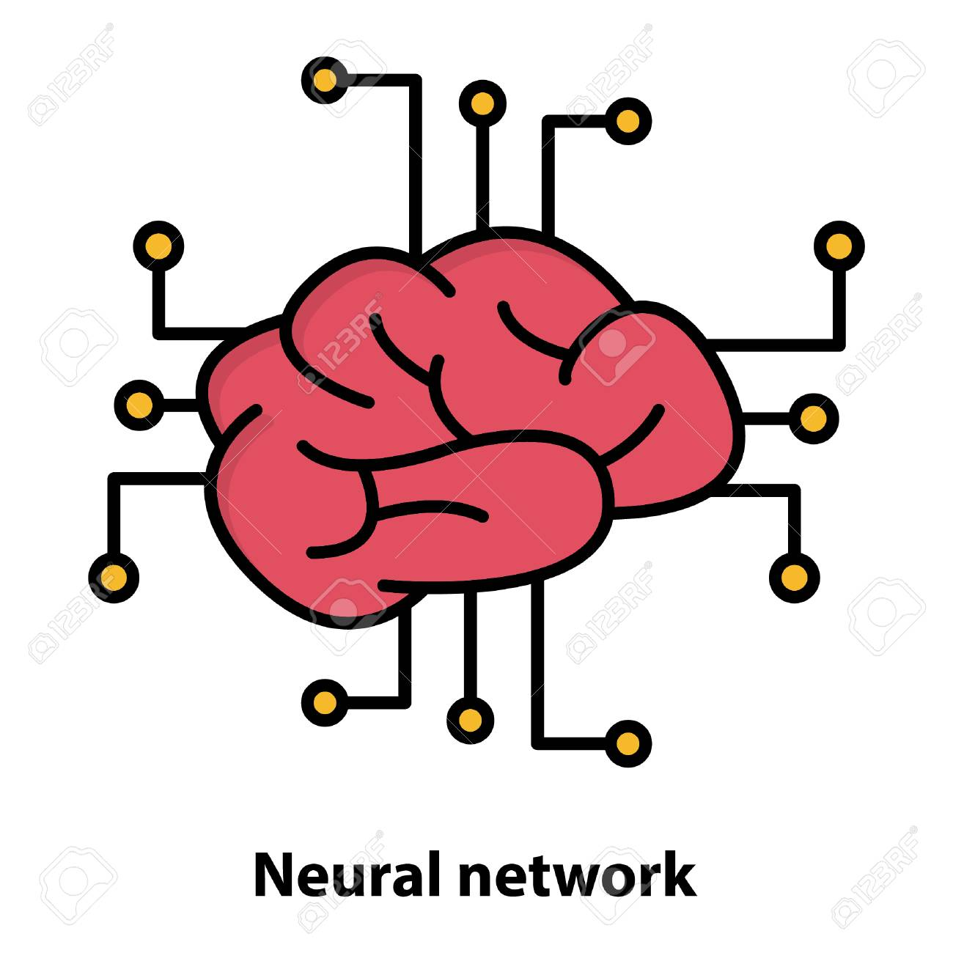


Roads ahead?
Station
sensors
Enhanced
Models
How many
sensors?
Data
Modifying/Increasing Data to more randomized vehicles!!
Incorporating Static sensors for further prediction(Ongoing)
Pollution Level/Class wise specific training to obtain good results.
Model Enhancements – GAT, Including RNNs,LSTMs
Experiments to answer queries such as “minimum number of sensors required”.
Thank you!

Slide 15
Thank You!

